Slide 1

Where Are You Now?
Where Do You Want to Be?
DISCOVER:
Your Current Enterprise Value
Your Potential Value
How to Close the Value Gap

Slide 2

You Are America’s Economic Engine
Family businesses account for 64% of the U.S. GDP
They generate 62% of the country’s employment…
…and account for 78% of new job creation.
Everyone is counting on your success.
Notes:
I don’t need to tell you that being a business owner carries a big responsibility. But it goes far and beyond the daily “job” of running a business.
America’s privately held businesses don’t always receive the credit they deserve when it comes to our nation’s prosperity. On average, for every job you create 7 more are created elsewhere.
You, your family, employees and their families, plus Main Street businesses and every client, vendor, supplier or customer all count on you for prosperous growth and successful transitions.
This is our mission: To help you be successful as an economic engine so you can grow or transition from your business, so that your place and legacy can carry on - so that our businesses and cities remain strong.

Slide 3








A Sneaky Suspicion All Business Owners Have:
We Could Be Better.
Notes:
But your job as a President, owner or CEO is a tricky one. You’re caught in a balancing act between what is and what you feel things could be.
I’ve never talked to a business owner, regardless of how successful the business was, that didn’t have a sneaky suspicion that things could be better. It’s in our nature to always be better. It undoubtedly led you in the belief that you could build a better mousetrap in the first place, and that’s why you’re a business owner. It’s in our DNA to always advance.
But in putting out the day-to-day fires, coordinating the business’s operations and keeping an eye on profitability, not to mention trying to architect and communicate your vision, the ability to work ON the business often takes a back seat to working IN it.
Therefore the constraints we all live under require a quick, automatic and progressive way to diagnosis and maintain your own business.

Slide 4

Things Are Always Changing;
New Priorities Come To Light.
GROWTH
Rapid Sales
Increased Profit
Processes Needed
STARTUP
Low Sales
Low/No Profit
Brand Unknown
MATURITY
Stable Sales
High EBITA
High Competition
POSSIBLE
EXTENSION
Innovation
Market Share
Increased Sales
DECLINE
Slowing Sales
Price/Profit ↡
Productivity ↡
↟
SALES
↡
Innovation
Personnel
Competitive Analysis
Senior
Leader
Operational Processes
Market Awareness
Brand Awareness
Profit Margins
Innovation
TIME ↠
Notes:
What we’re all going to see today applies to all businesses at any stage of their maturity. In fact, monitoring your business on a yearly basis with the simple analysis we’re going to run through today will help you overcome the obstacles in each stage - and avoid the inevitable decline.
Let’s look at a couple of examples - some you may have already encountered or are living through right now:
CLICK
As a startup, innovation is key to your market entry and success: “What’s your better mousetrap?” During this phase getting your brand out to the masses becomes one of your biggest challenges, and likely the owner as the senior leader is full of optimism and the sole driver for marketing and sales.
CLICK
The growth phase may sound rosey, but now you’ve encountered a new set of challenges. You’ll be hiring a lot of new people, which will dictate that organization and process snafus will occur. That calls for procedures to be worked out, and during rapid growth you’ll need to keep on eye on profitability or you could grow yourself out of business.
CLICK
Then comes the sweet smell of success in a mature company. Things are stable, the bottom line is probably the best it’s ever been, but with market superiority comes a new battlefront from competition that is going to eat your lunch. At this point you’re at the apex and staring down a deep cliff of decline. Now the challenge is going to call for - once again - innovation, customer awareness about the next generation of their likes, dislikes and demands, a look at whether you have room to run and what the next phase of market growth looks like. A really good example of a company that didn’t adjust to this phase was Blackberry. In its day, Blackberry was the industry leader in smartphones among professionals. It enjoyed rapid growth, high profitability and market dominance for a long time until it hit the Maturity phase of its lifecycle. Then competition decided how they could build a better mousetrap, and they did. Blackberry refused to adapt. It quickly crashed and burned.
The business lifecycle is universal. The challenges in each phase are also universal. Regardless of size or industry, they’re predictable. If you are suffering from a problem at work you’re not alone. Others suffer from some of the same issues at some point in the business lifecycle. As business owners we need a way to quickly assess where we are at and what’s going on, and then how to counter the problems.

Slide 5


You cannot gain clarity by looking at the forest.
Market Drivers
Growth
Large Potential Market
Dominant Market Share
Recurring Revenue
Barriers to Entry
Product Differentiation
Brand
Margin Advantage
Customer Diversification
Operational Drivers
Business Overview
Financial
Sales & Marketing
Operations
Customer Satisfaction
Senior Management
Human Resources
Legal
Innovation
Focus on the trees.
—----------------------------------------------------------------------------
$ TOTAL VALUE $
Potential Value
How to Close the Gap
Notes:
One of the quickest ways to diagnose your business is to concentrate on the trees, not the forest. It’s too hard to look at the whole business and determine what’s really going on at a granular level. But if we focus on the individual pieces we gain clarity about those parts and how they fit within the entire forest. That’s what we’re going to do today.
CLICK
In a minute we’re going to look at 18 individual, operational parts of your business. These are inherent in all businesses, regardless of the industry. Nine of these things, or Drivers as they’re called, are Market Drivers - things that are outside pressures that you may not have total control over, but for which you should know how to respond. The other nine Drivers are Operational Drivers. They are internal in nature and totally under your control. In each case we need to know how to analyze these drivers in order to develop a plan of action.
CLICK
Then we’re going to roll things up, step back, and see how these individual drivers determine the value of the whole forest - your business. We’ll also see your potential value and how to close that value gap.
The things we’re going to measure through a quick assessment impact your business, but they are also, by the way, how an investor or buyer will look at the value of your business - one tree at a time. When you understand what parts of your business are operationally excellent, and which ones could use some tweaking, you’ll find yourself optimizing your business asset either for growth or transition.

Slide 6

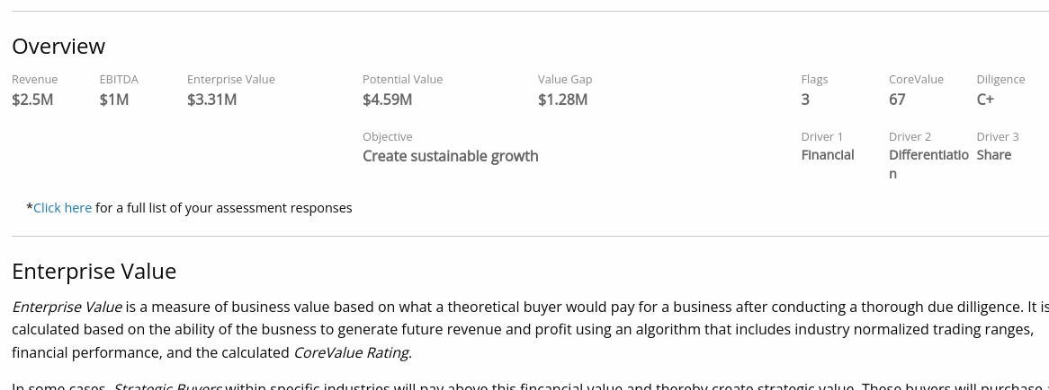
Where Are You?
Where Could You Be?
How Do You Get There?
Market Drivers
Growth
Large Potential Market
Dominant Market Share
Recurring Revenue
Barriers to Entry
Product Differentiation
Brand
Margin Advantage
Customer Diversification
Operational Drivers
Business Overview
Financial
Sales & Marketing
Operations
Customer Satisfaction
Senior Management
Human Resources
Legal
Innovation
Notes:
When you’ve completed the questions, you’ll instantly receive a report on your phone. You and I will be the only ones that ever need to see it, but the accuracy and importance of the findings will only be as serious as you take the questions.
CLICK
We’re only going to ask 2 financial questions; your yearly revenue and your yearly EBITA, or Earnings Before Interest, Taxes and Amortization. Writing off interest, taxes and amortization are tax strategies you can take advantage of, but they are not an indicator of your operations as it exists today, so we want to know your EBITA. This, rather than your final profit as shown on a tax form, is also what an investor or buyer will want to see. Answer these as closely as you can, even if you’re not 100% sure. If you have no idea what your EBITA is, Business Digest suggests 14% of revenue as the average small business EBITA.
CLICK
One of the first things shown in your report will be your current enterprise value. This is where you are today. If you answer questions honestly this is the value of your business you could reasonably expect if you were to put it on the market today.
CLICK
The next thing you’re going to see is your potential value and the value gap - or the difference between the current value and the potential value. This, like the enterprise value, is a calculation of the algorithm running in the background. It represents where you could be in terms of company value.
CLICK
Finally, the report is going to show you how to close the value gap - how to get to your potential value. It will highlight the top 3 drivers that are handicapping your current value. In this case, this company is struggling with issues around their financials, product or company differentiation, and their share of the available market - all things we considered as we looked at the slide with the business stages. The rest of the report will dive into more detail for further understanding.

Slide 7

bit.ly/t123cy2
Notes:
So let’s get started. Pull out your smartphone and enter the link you see on the screen in a search bar. While you’re doing that let me go over a few housekeeping things:
Like I said, be as accurate as you can be to get the most out of your report.
Don’t try to hide and put in a false email address. You won’t get your report.
In a few seconds you’re going to see some multiple choice questions. These are on the 18 Drivers. My advice would be to go with your gut. You probably have a gut feeling about how your business is doing in all of these areas. Go with your first choice. Don’t try to overanalyze this or give me what you think I want to hear. Your report is like your golf score - it’s only as honest as you are.
When you’re into the assessment, if you see a page with some introductory text, go ahead and read it and then advance to the first set of questions.

Slide 8

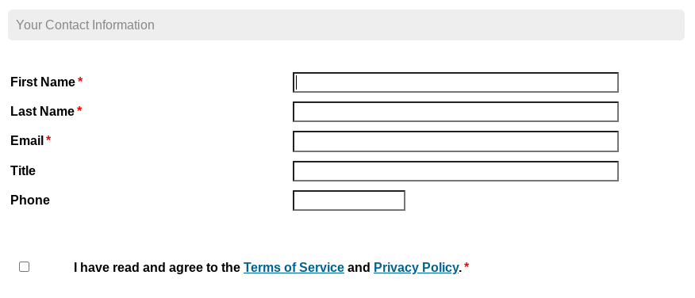
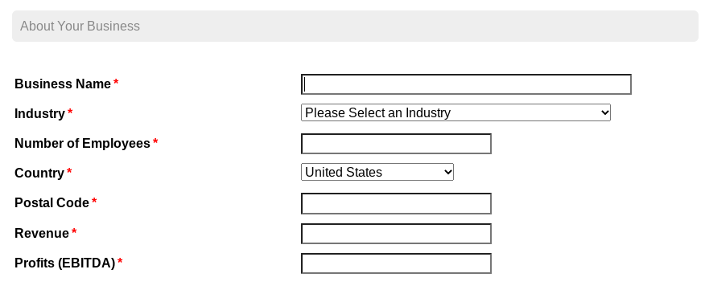
Notes:
Nothing hard here, simply put in your contact information so you can get a copy of your report. Scroll to the bottom and hit “continue”.
On the next screen, put in your business name and the other information requested. There are 2 reasons for this capture: 1) we will be preparing your enterprise value calculations so we need those 2 financials, and 2) our massive data warehouse will be comparing your business to others in the same industry, size and region of the U.S. We don’t want to compare you with a Fortune 500 in the same industry, and we don’t want to lump a professional service in with someone in manufacturing. We also don’t want to compare your company to others in different parts of the U.S. They are obviously valued differently.

Slide 9

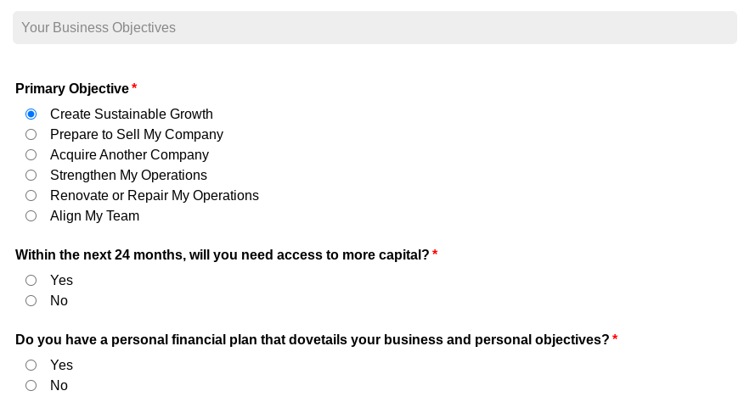
Notes:
Next, as of today what is your current objective or need within your company? What is the overarching goal you want to achieve?

Slide 10
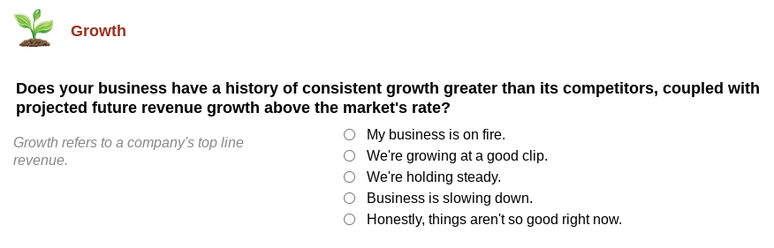

Notes:
Now we’re going to get into those multiple choice questions about each of the 18 Drivers. Simply click on the best answer for your present situation. The little grey text will give you some additional food for thought.

Slide 11

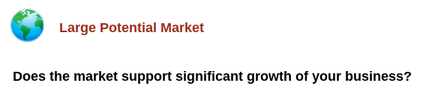
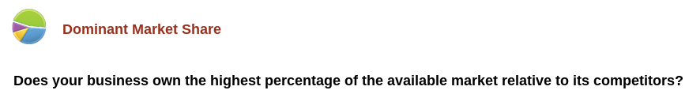
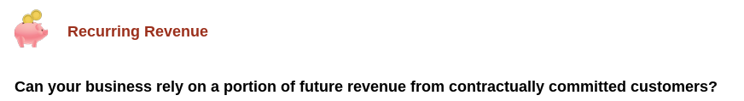
Notes:
What’s the size of your market potential? In other words, do you have room to grow?
How are you doing in terms of capturing the available market?
Next, how assured are you that tomorrow’s customers or clients are going to pay your light bill? Some industries don’t have contractual agreements with customers. But they make up for future assurances is other ways, such as a grocery store in a high traffic area. Some should have contractual arrangements in place, such as a manufacturer who has a customer with a large order that will occupy a large percentage of the available operations or output.

Slide 12

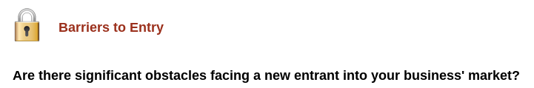
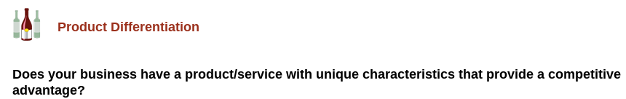
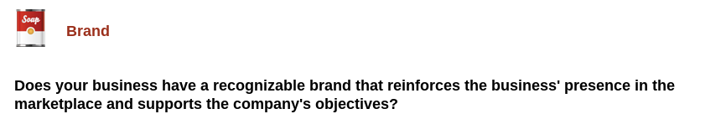
Notes:
Do you have reason to believe that it would be hard for a competitor to move in next door and steal market share from you? Would it be easy?
Can your articulate your competitive advantage to the world? If you were on Shark Tank, how would you describe your unique selling position?
Does your market world recognize your brand, and does your brand tell who you really are?

Slide 13

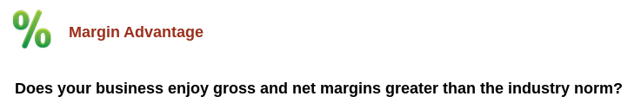
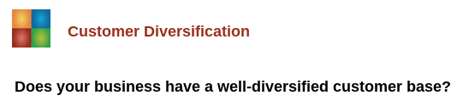
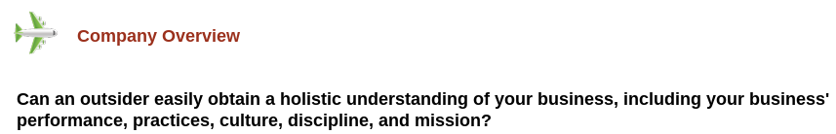
Notes:
Do you know what the norm is for margins in your industry, and have you ever looked your margins by product or service line?
Do you have enough customers so that if one left you’d be fine? Many manufacturers who supply box stores, for example, get caught up in the notion their contract will always be there, and they devote too many resources to keeping the big fish happy. But today doesn’t guarantee tomorrow and if that contract was suddenly gone they’d be scrambling.
The company overview question is about your company culture as a whole. If an investor, buyer or large customer came in, could they easily determine your mission, values and be satisfied that you could deliver what your promise?

Slide 14

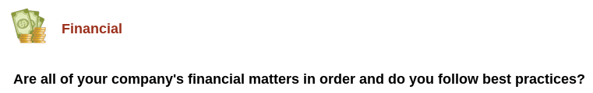
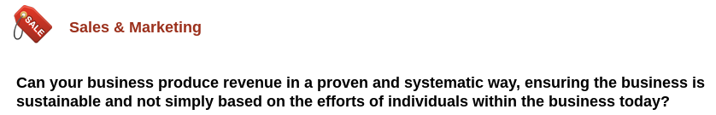
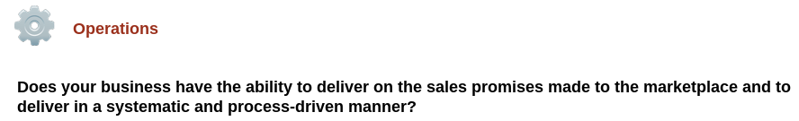
Notes:
Basically, this question is asking if you’d sweat it out during an audit?
If you lost a key salesperson who was responsible for bringing in a large portion of your revenue, would you be able to get someone new up to speed quickly and pumping cash?
Is there a disconnect between what sales promises and what you can deliver to customers or clients? Is there a documented process everyone follows?

Slide 15

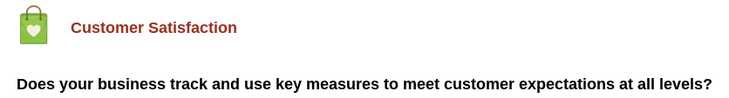
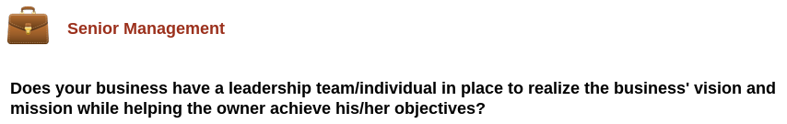
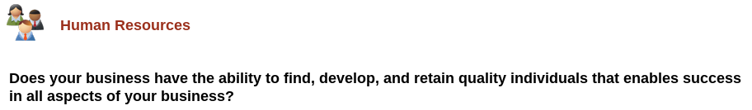
Notes:
What do your customers think of you? Are you sure? There’s no faster way toward customer churn than thinking all things are ok without finding out for sure.
The flip side of the Senior Management question may have to do with you: Are you an octopus who has your hand in every fire for every decision, or can key people manage the business in your absence?
Human resources doesn’t just refer to hiring and firing, or helping employees answer benefit questions. It contributes a lot to the understanding of everyone’s role within the organization as they work together to deliver what you provide.

Slide 16

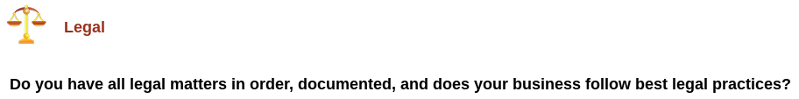
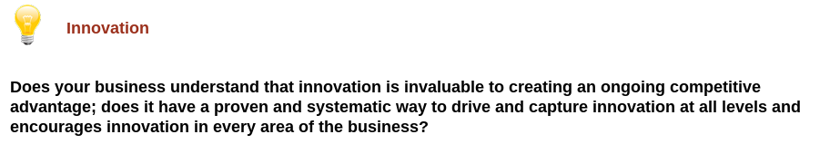
Notes:
Legal - think about contracts, protected IP, buy-sell agreements: Are you buttoned up on all fronts?
Last question - are you confident that you’re staying ahead of the consumer, client or customer trends? Do you have a way to monitor what the world wants or what might pop up to rob your innovative place in the marketplace? Remember Blackberry?

Slide 17

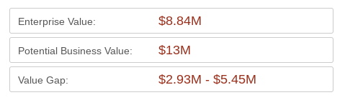
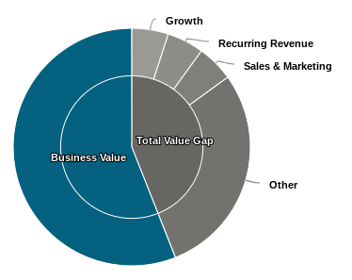
Where Are You?
Where Could You Be?
How Do You Get There?
Any Surprises?
Notes:
Let’s take a moment for you to look at your own reports. You’ve discovered where you currently stand in terms of enterprise value, where you could go. You’ve just looked at your business and separated the forest from the trees by analyzing the 18 Drivers and discovered what areas you might want to focus on to close that value gap.
If you feel comfortable, ask if there are any questions.
At this time you can switch to the Aggregate View:
Just for fun, let’s look anonymously at the combined results from the room. (Switch to Aggregate View, but come back to the next slide to make your sales pitch.)

Slide 18

YOUR LOGO
And Contact Information
Notes:
The report you received today is valuable, but only if you make it actionable. If you would like to take a deeper look at what was revealed in your report, or potentially know how to fix the problematic Drivers for your business, I offer a deeper assessment that outlines specific activities we can do to close your value gap. My contact information is on the screen and you’ll also find in within the handouts I’ve provided. It doesn’t matter what stage of the business lifecycle you are in, whether you are going for continued growth or looking at transition. I’d love to meet with you and talk about what’s possible and how to get there.

